Slide 1

UIUCTF Pre-game
BYU CTF Group

Slide 2
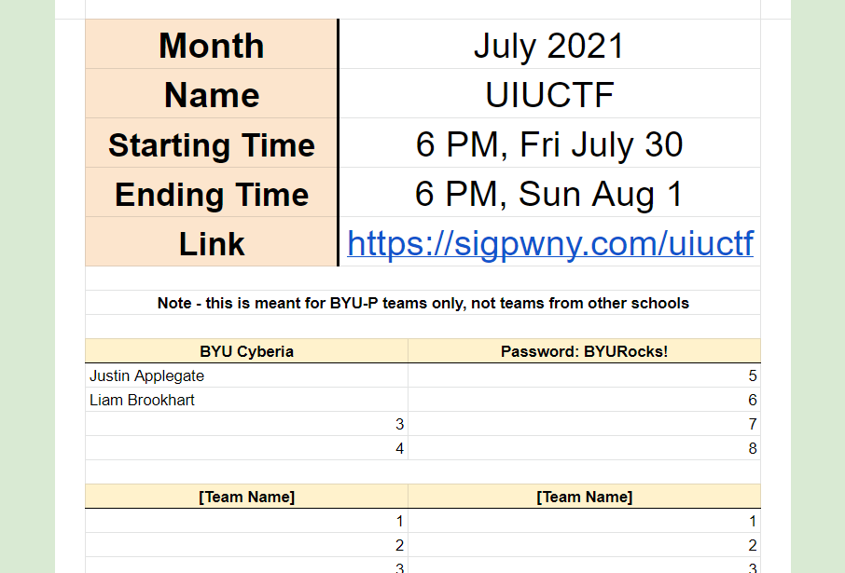
What, Where, When, and Who
https://sigpwny.com/uiuctf
https://docs.google.com/spreadsheets/d/1IJFxKex4hBtoq8zYiCy1NN9ITDEmBLNb1SiwHKErP-Q/edit

Slide 3
UIUCTF Rules
1. No flag sharing or helping other teams in any unfair way. This will result in immediate disqualification from the event
2. No attacking the infrastructure, this includes tools such as Nmap (you won’t need it unless explicitly stated)
3. No dumping flags at the last minute, submit the work when you solve it
4. Don't do anything Orange or below on the CTF tactics Iceberg (https://twitter.com/gf_256/status/1206393845497376768/)

Slide 4
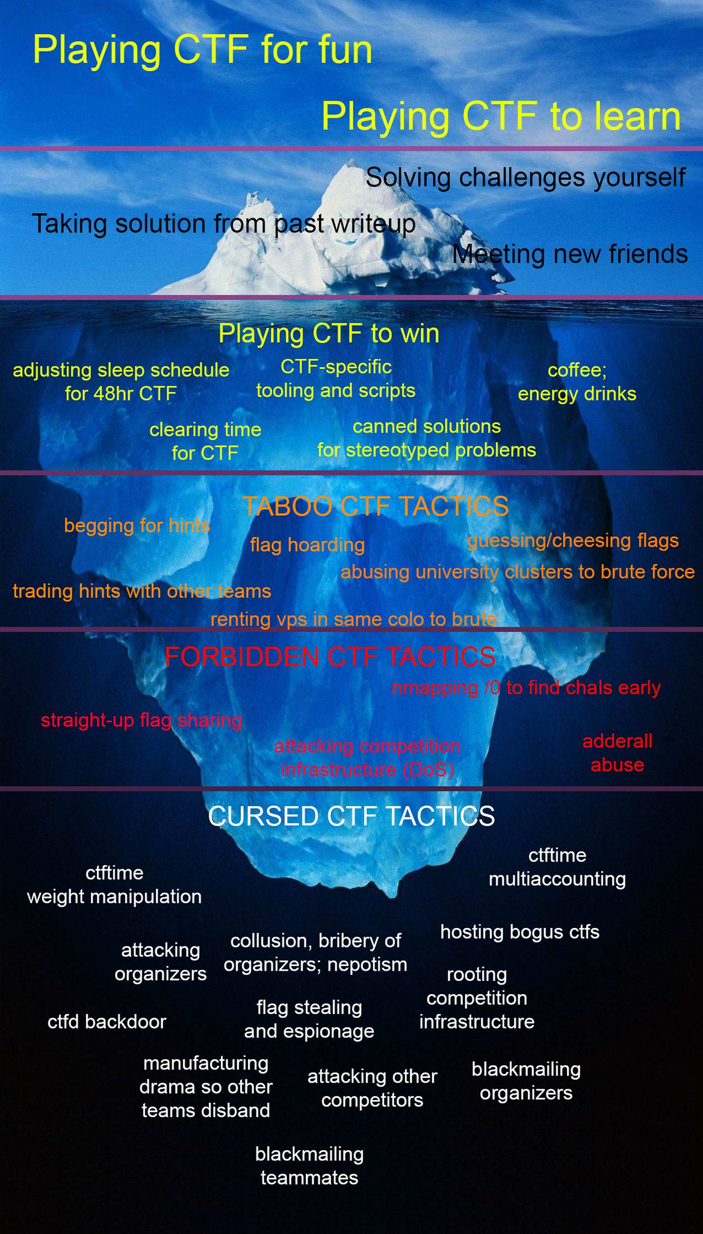

Slide 5
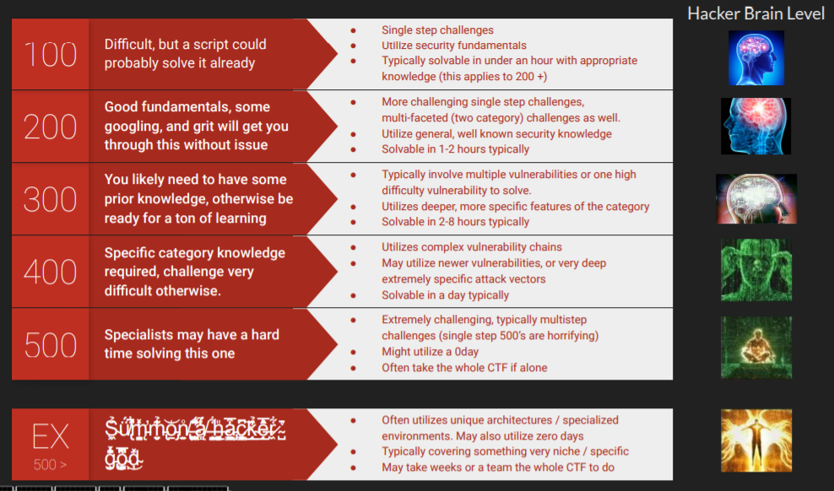
Point System
Goal

Slide 6
Prizes
1 - $2,048.0
2 - $1,024.00
3 - $512.00
4th to 10th - $256.00
Would be awesome if we got in top 10, but not super planning on it. We’re hoping to get into the top 10% again this competition.
There will also be $2,000 in writeup prizes!!! Writeups will be due one week after the event ends, they will release a form for submission right at the end of the event.

Slide 7
Goals
Get all flags for challenges worth < 400 points
Get in the top 10%
Make write-ups on all the challenges we solve (hosted on our GitHub)

Slide 8
Who’s making the competition?
Undergraduate students at the University of Illinois at Urbana-Champaign (UIUC)
Undergrads – easy then, right?
Based on some profiles that I found using OSINT, some of these undergrads have found multiple zero-day vulnerabilities for years. So they’re something like hacker gods. Great ☺

Slide 9
Flag Format
uiuctf{flag}

Slide 10
CTF Categories From Last Year
Type | Total Questions | Percentage | Average Points
Kernel (Linux exploitation) | 10 | 22% | 266.6
Pwn (binary exploitation) | 4 | 9% | 412.5
Forensics | 5 | 11% | 234.0
Reverse engineering | 6 | 13% | 314
Cryptography | 4 | 9% | 250
Web | 8 | 17% | 202.5
OSINT | 6 | 13% | 63.3
Miscellaneous | 4 | 9% | 72.5
TOTAL | 46 | 100% | 224.9
https://ctftime.org/event/1075/tasks/

